Slide 1
Cyber Security
--Sri Harsha, CyberEye.

Slide 2
Sample text
Cyber Security is Everyone’s responsibility

Slide 3
SOFTWARE SECURITY

Slide 4
What is Computer Security?
Computer Security, more recently known as Cyber Security is an atribute computer System.
Most developers and operators are concerned with Correctness: achieving desired behaviour.
Eg :- If I’m developing a word processor , i’m concerned that when a file is saved and reloaded they do get back my data where i left off.

Slide 5
Security also concerned with preventing undesired behaviour under wide ranging circumstances.

Slide 6
Kinds of undesired behaviour :
Stealing Information : Confidentiality
Corporate secrets (product plans, Source code etc..)
Personal secrets (Credit card numbers, SSNs and so on..)
2. Modifying information or functionality : Integrity
Installing unwanted softwares (spyware , botnet client and so on..)
Destroying records (accounts , logs, plans,..)
3. Denying access : Availability
Unable to purchase product.
Unable to access banking information.

Slide 7
Significant Security breaches :
RSA , March 2011
Stole tokens that permitted subsequent compromise of customers using RSA SecureID devices.
Adobe , October 2013
Stole source code , 130 million customer records (including Passwords).
Target , November 2013
Stole around 40 million credit and Debit cards.

Slide 8
How did the attackers breach these systems?

Slide 9
Defences and Vulnerabilities :
Many breaches begin by exploiting a vulnerability.
This is a security-relevant software defect that can be exploited to effect an undesired behaviour.
A software defect is present when the software behaves incorrectly, i.e.,it fails to meet its requirements.
Defects occur in the software’s design and its implementation.
A flaw is a defect in the design.
A bug is a defect in the implementation.

Slide 10
What is Software Security?

Slide 11
Software Security :
Software security is a kind of computer security which focuses on design and implementation of software securely.
Using the best tools, methods and languages.
Focus of study :
the code (White box approach)
By contrast: Many popular approaches to security treat software as a black box (ignoring the code).
OS security, firewalls and so on..

Slide 12

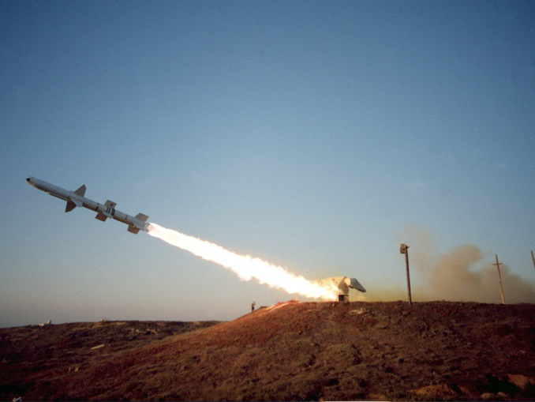
Why Software Security?
Firewalls and antivirus are like building walls around a weak interior.
Attackers often can bypass outer defenses to attack weaknesses within.

Slide 13
Let us see a few standard methods for security enforcement and see how their black box nature presents limitations that software security techniques can address!!!!

Slide 14
Operating System Security :
Operating systems mediate a program’s actions
Aka system calls (actions done by a program that is executing).
Includes reading and writing files,
Sending and receiving network packets,
Starting new programs etc.
Enforceable policies control actions
Programs run by Alice cannot read files owned by Bob.
Programs run by Bob cannot use TCP port 80.
Programs run in directory D cannot access files outside of D.

Slide 15
Limitations of OS Security :
Cannot enforce application-specific policies, which can be too fine-grained.
Eg :- Database Management System (DBMS).-it is a server that manages data whose security policy is specific to an application that is using that data.
Cannot (precisely) enforce into-flow policies
An operating system typically implements an
execution monitor : decisions are based on past and current actions.
Information flow policies: A non-action may reveal something about a secret without leaking it directly

Slide 16
Firewalls and Intrusion Detection Systems (IDSs) :
Firewalls and intrusion detection systems (IDSs) observe, block, and filter messages exchanged by programs
Based on their origin, frequency, content etc.
Examples:
Firewall may block all attempts to connect to network servers except those listening on designated TCP ports.
An IDS provides more fine-grained control by examining the contents of network packets, looking for a suspicious patterns (exploit pattern).

Slide 17
Filtering misses attacks:
Firewall filtering is coarse-grained, and unsound
Port 80 is assumed to be HTTP (web) traffic, which is assumed benign, but can layer arbitrary traffic over HTTP, e.g., SOAP.
Previously benign sources can become malicious.
E.g., due to malware infection
IDS patterns fine-grained, but still unsound!
Attack traffic can be slightly modified to work around IDS filters (which are often syntactic, not semantic).
Making filters too fine-grained can hurt performance-Thus compromising availability.

Slide 18
Anti-virus Scanners:
Anti-virus scanners looks for signs of malicious behaviour in local files.
These are quite similar to IDSs, but they operate on files and have less stringent performance requirements as a result.
Newer forms of anti-virus scanners are sophisticated, but in practise are frequently bypassed.
Trade of precision and performance(latter could compromise availability).

Slide 19
Now, we conclude our comparison of software security to black box security with an example the heartbleed bug.

Slide 20
The Heartbleed bug:
SSL/TLS is a core protocol for encrypted communications used by the web.
The heartbleed is a serious vulnerability in the popular openSSL cryptographic software.(i.e.,openSSl implementation of SSL/TLS, v1.0.1 - 1.0.1f)
Discovered in March 2014, it has been in released code since March 2012.
The Heartbleed bug allows anyone on the Internet to read the memory of the systems protected by the vulnerable versions of the OpenSSL software.
Leaking passwords, secret keys and other private information.
This is an example of buffer overflow.
Reference : heartbleedbug.com

Slide 21
Black box security is incomplete against Heartbleed exploits.
Issue is not at the level of system calls or deposited files: nothing the OS or antivirus can do.
Basic attack packets could be blocked by IDS, but
“Packet chunking” may bypass basic filters.
Exfiltrated data on the encrypted channel; invisible to forensics
Software security methods attack the source of the problem: the buggy code

Slide 22
Low-Level Security :
-Concern for systems written in a c/c++ programming languages.
We will begin with the infamous buffer overflow attack.

Slide 23
What is Buffer overflow?
A buffer overflow is a bug that affects a low-level code, typically in c/c++, with significant security implications.
Generally, a program with this bug will crash.
But an attacker can alter the situation that cause the program to do much worse
Steal private information (E.g: heartbleed bug)
Corrupt valuable information.
Run code of the attacker’s choice

Slide 24
Do we need to study them?
Yes, because buffer overflows are still relevant today.
C and C++ are still popular
Buffer overflows still occur with regularity
They have a long history
Many different approaches developed to defend against them, and bugs like them.
They share common features with other bugs
In how the attack works
In how to defend against it

Slide 25
Critical systems in c/c++
Most OS Kernels and utilities
Fingered, X windows server, shell
Many High Performance servers
Microsoft IIS, nginx, apache httpd
Microsoft SQL server, MYSQL, redis, memcached
Many embedded systems
Mars rover, automobiles, industrial control systems
A Successful attack on these systems is particularly dangerous!

Slide 26
Memory Layout
For understanding buffer overflows, we need to know how programs are laid out in memory

Slide 27
All programs are stored in memory (considering a 32-bit machine)
4G 0xffffffff
In reality these are virtual addresses; the OS/CPU maps them to physical address.
0 0x00000000
The processor’s view of memory it owns all of that.

Slide 28


The
instructions
themselves are in memory
4G
^{0xffffffff}
...
0x4c2 sub $0x224,%esp
0x4c1 push %ecx
0x4bf mov %esp,%ebp
0x4be push %ebp
...
Text
0
^{0x00000000}

Slide 29








Location
of
data
areas
4G
^{0xffffffff}
Set when
cmdline & env
process starts
int f() {
int x;
Stack
Runtime
…
Heap
malloc(sizeof(long));
Uninit’d data
static int x;
Known at
compile time
Init’d data
static const int y=10;
Text
0
^{0x00000000}

Slide 30





Memory
allocation
Stack and heap grow in opposite directions
Compiler
adjust the size
emits instructions
of
the
stack at run-time
{
^{0x00000000}
^{0xffffffff}
Heap
3
2
1
Stack
apportioned by the OS;
managed in-process by malloc
Focusing on the Stack …
Stack
pointer
push
push
push
1
2
3

Slide 31
Stack and Function calls:
What happens when we call a function?
What data needs to be stored?
Where does it go?
What happens when we return from a function?
What data needs to be restored?
Where does it come from?

Slide 32
Basic
stack
layout
void func(char *arg1, int arg2, int arg3)
{
char loc1[4]
int loc2;
...
}
^{0xffffffff}
… loc2 loc1 ??? ??? arg1 arg2 arg3 caller’s data
Local variables
pushed in the same order as they appear
in the code
Arguments
pushed in reverse order of code
The local variable allocation is ultimately up to the compiler: Variables could be allocated in any order, or not allocated at all and stored only in registers, depending on the optimization level used.

Slide 33
Accessing variables:
In the previous function (“func”), we don’t know where loc2 is stored.
And if this function could be called from many different places in the program, the actual address of loc2 could differ depending on who called the function.
Therefore, the compiler cannot know the address at compile time and it’s going to need to do something else.
Fortunately, the compiler always know the relative address of the variable.
Now that, we are refreshed in basics of how C programs are laid out in memory.We can start looking at buffer overflow attacks.

